Slide 1
SOCIAL MEDIA BOSS
with: My Designs in the Chaos
Notes:
Introduction….. Hello… My name is Michelle owner of My Designs in the Chaos where we develop encourage and grow talent and confidence
We have grown our Social Media following from 0 to over 11,000 combined from our page and groups in about 1 year 99% organically

Slide 2
HOUSEKEEPING
Questions
Email List (i-pad)
Presentation on my website
www.mydesignsinthechaos.com
Notes:
Questions….
Want free SVG files and project inspiration…. Email
I will have the presentation available on my website

Slide 3
SOCIAL MEDIA
Facebook
Instagram
Pinterest
Twitter
Snap Chat
Linked In
Notes:
Places that you can connect online and build an audience for basically free to sell to.
The main one we are going to look at today is FB…
Then at the end I will give you a couple quick tips for IG and Pinterest

Slide 4
FACEBOOK
1. Personal Profile
2. Business Page
3. FB Groups
public
closed
secret
Notes:
3 ways to connect with people on Facebook
(specifically your target market)
Personal profile *can’t sell due to FB terms of service*
Business Page is the only place you can run ads from
FB Group creates connections and community
3 types of FB groups
*Friends can’t see what they are posting if it is a closed or secret group
Focus on your FB business Page today!

Slide 5
TOP 5 TIPS TO GROW YOUR FACEBOOK PAGE
Notes:
Top 5 tips to help you grow engagement and your FB business page.

Slide 6
1. POST CONSISTENTLY
Trains the algorithm
Keeps your info in your
audience’s feed
Notes:
1. Trains the algorithm: It knows then when the posts are coming… who to show them to… and who will probably respond
As more people comment, like and share your post, the more reach your post will have. You should aim to have around 10-20% reach on your posts….. And as much engagement as possible. Engagement always is the priority because when people are engaged the likes will follow...
If things aren’t regularly spaced out on your social media it gets skipped bc the algorithm doesn’t have time to catch what is working and what isn’t
How the algorithm has to be trained……..Have you ever had something… maybe even a crafting thing…. that you see shared a ton on your feed? That’s because FB is picking up that all the people who are liking and sharing it are people similar to you and they think it’s something that you might enjoy.
We have to train FB not only the time we post but the types of posts and who to show our posts to.

Slide 7
2. POST THINGS OTHER THAN WHAT YOU SELL
Make sure they interest your target market
Trial and Error
Notes:
2. Sounds counter intuitive but it will create a relationship which is step one in building an online following (real connections)
Make sure they interest your target market
Styling tips
People buy things from people they know, like, and trust….. You want to build a relationship and become a resource with them.
Jab, jab, jab, right hook
You want to post something that leads to your website (like a blog post etc.) no more than once a day and then actual sales post once every 2 days (max).

Slide 8
QUESTIONS

Slide 9
3. ASK QUESTIONS
Get your page talking
Notes:
3.
Talking not only to you but also to each other (tagging friends, sharing your posts…. Things that inspire, that speak to them and for them, things that they can relate to)
3 things they can do on your post….
like (heart, surprise)
comment
share
The more that people talk and engage the more FB will show your page to others who they think will also like your stuff……
Become a resource for them….. Ask their opinion

Slide 10
Ways People Can Interact
Reaction
Comment
Tag
Share
Notes:
The two in the algorythim right now that are huge are comments and tags….

Slide 11
4. VARIETY
Status Updates
Photos
Videos
Shares
Notes:
4. Variety of the types of posts you create
You want to do a variety of these types of posts again to feed the algorithm and keep your audience engaged.

Slide 12
Status Update

Slide 13
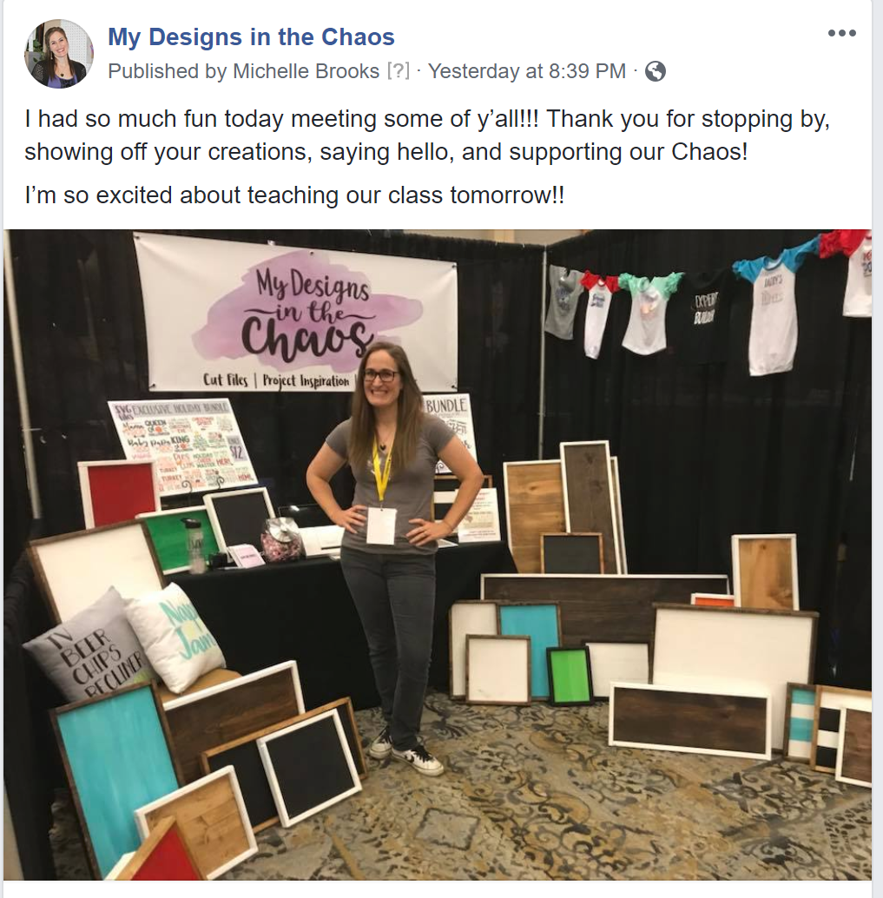
Photo

Slide 14
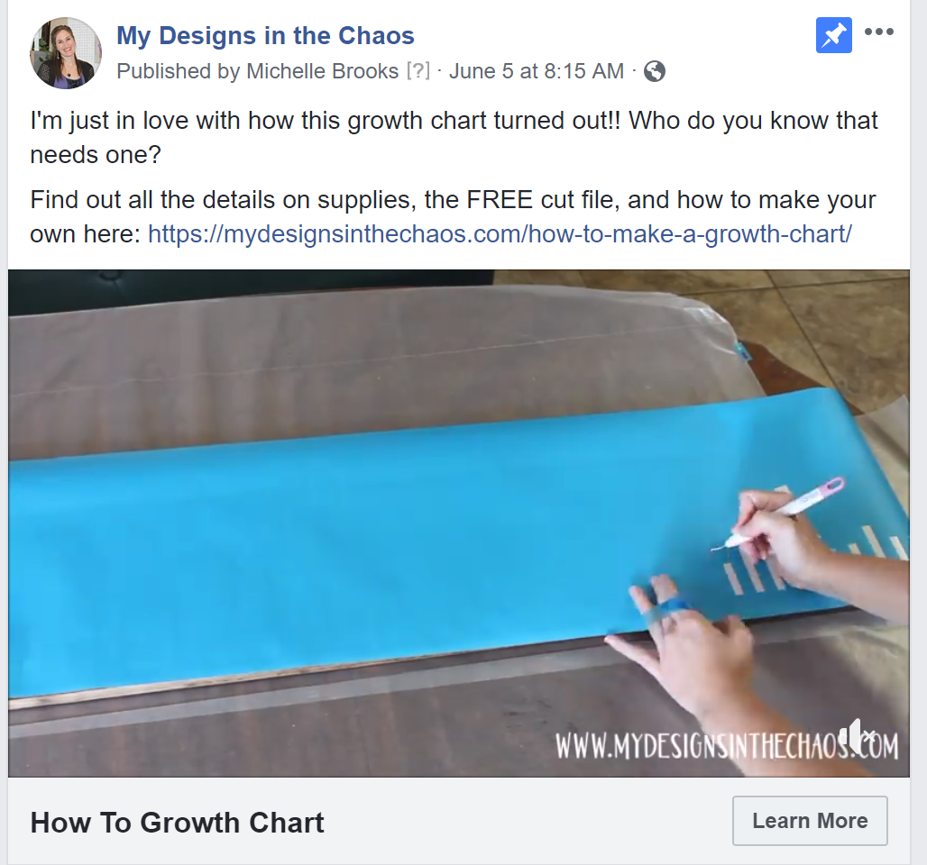
Video

Slide 15
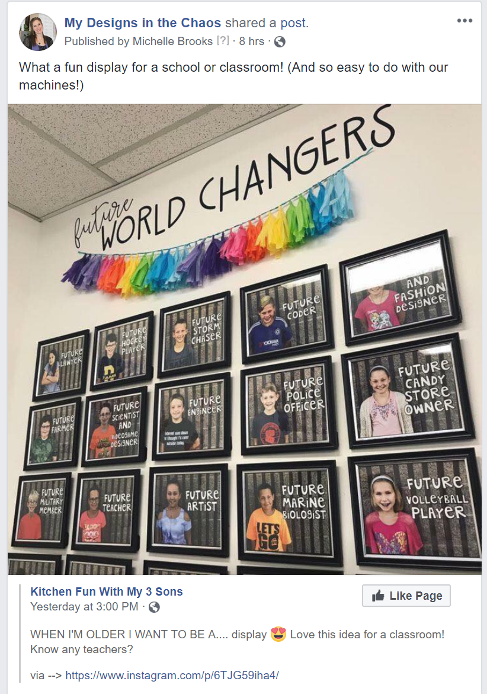
Share
Notes:
Share from larger pages who have the same audience that you are trying to attract.

Slide 16
5. MAKE IT FUN!!
Encourage, Inspire, Motivate
Notes:
Make it Fun
People go to FB to zone out, smile, and feel good.
Again people buy from people they know like and trust…. Make them smile and feel good. Encourage, Inspire, and wow them etc.

Slide 17
REVIEW
Consistency
Don’t just post sales
Ask Questions
Give your audience variety
Make it Fun
Notes:
Review the top 5 ways to grow your page.

Slide 18
Helpful Hints
Invite people who like your posts (not just random friends and family)
Create beautiful graphics in Canva
Test Test Test
Schedule
Always site the source
Notes:
Invite people who have already engaged with your content to like your page. You want people who like your stuff and not just family and friends. You want the people who are potential buyers.

Slide 19
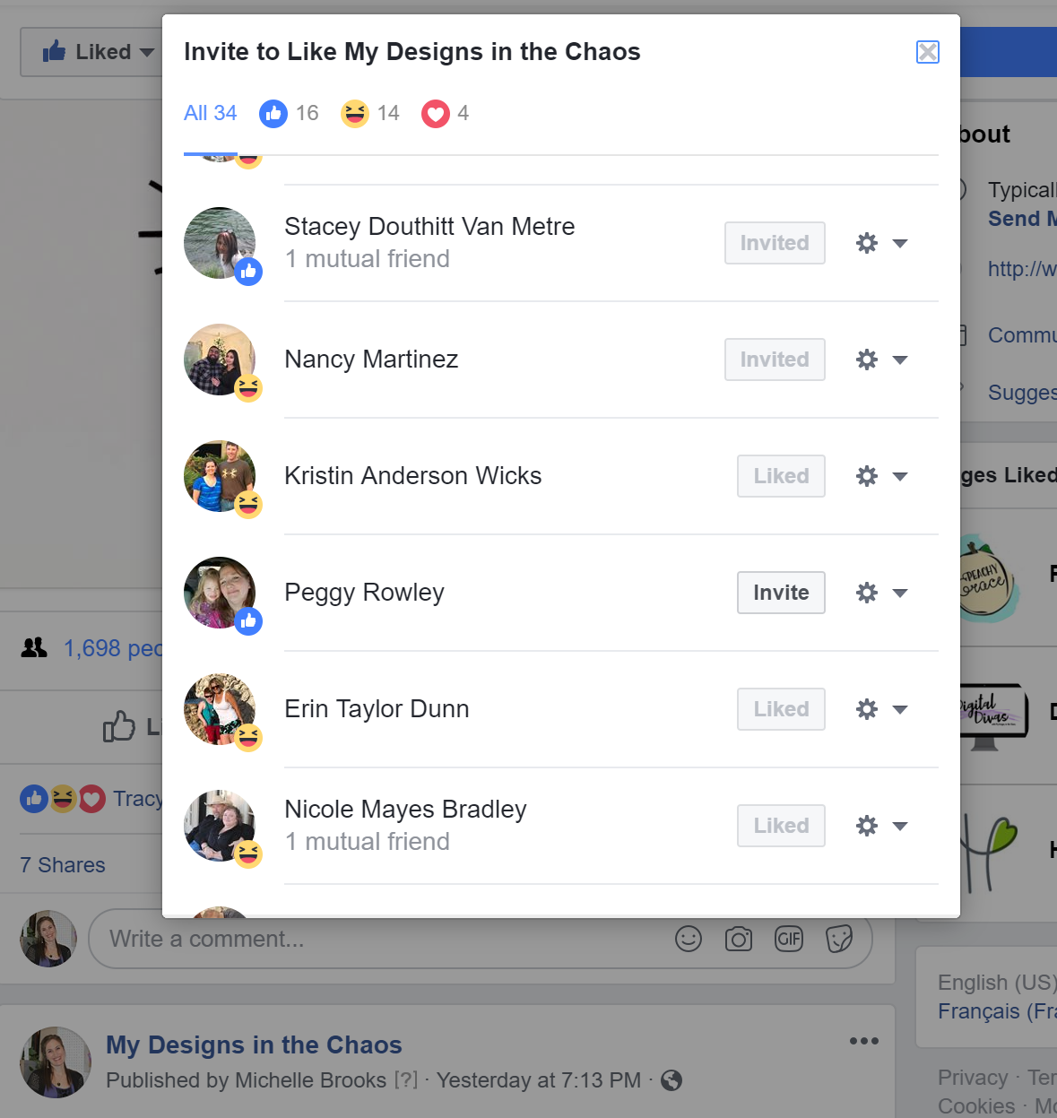
INVITE YOUR PEOPLE
Notes:
From your business page
On the posts your business page has made

Slide 20
QUESTIONS

Slide 21
INSTAGRAM TIPS

Slide 22
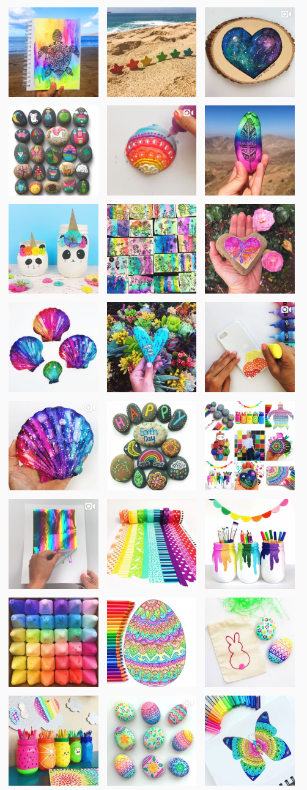
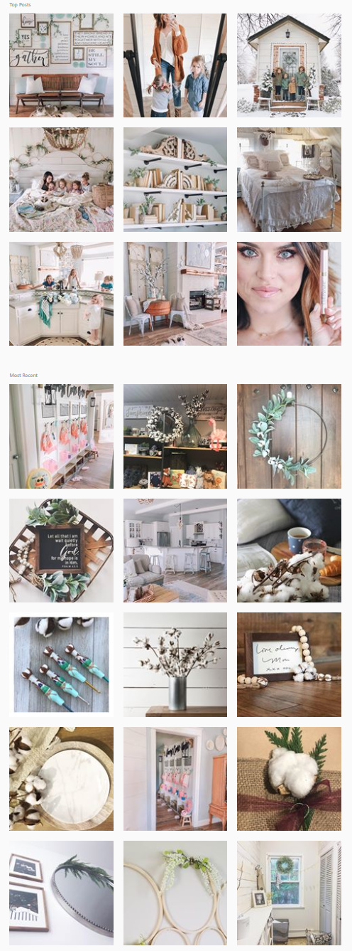
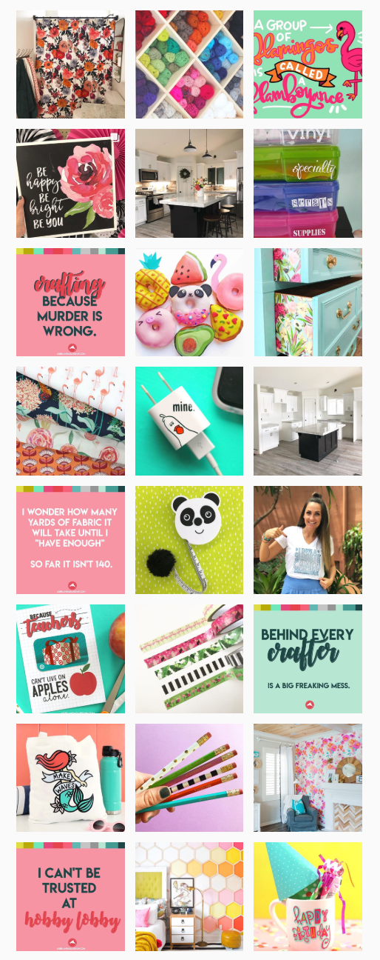
COLOR SCHEME
Notes:
Pick 3-5 colors
Use the same filters

Slide 23
BE DIFFERENT
Notes:
Be different than your other social medias…… give people a reason to follow you on more than one place

Slide 24
USE HASHTAGS
Notes:
Think of things that your target market would search
This is how people find your things

Slide 25
LAST QUESTIONS

Slide 26
THANK YOU!
WWW.FACEBOOK.COM/MYDESIGNSINTHECHAOS
MYDESIGNSINTHECHAOS@OUTLOOK.COM
WWW.MYDESIGNSINTHECHAOS.COM

